Slide 1
STOCK PRICE PREDICTION
RNNs & Transformers

Slide 2
Recurrent Neural Networks
Transformers
Gaussian Process Regression

Slide 3
Recurrent Neural Networks
Transformers
Gaussian Process Regression

Slide 4
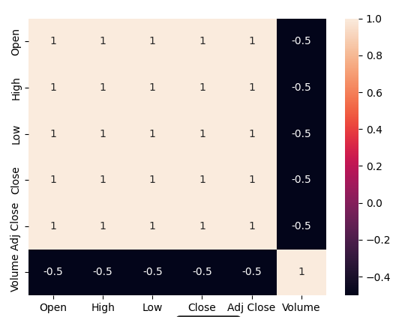
Dataset Used
Used the yfinance API to download stock price data of various stocks daywise from 2007 till now
The downloaded data consisted of Various features like Opening, Closing, High, Low prices
But the features are correlated as shown on the Right.
So we only used the CLOSE feature.
we want to build a model , which can predict the stock price
for the next N days, given the prices in a window of T days.
Each datapoint in the dataset (x,y) is of the form x R^{T}, y R^{N}
x_{t} = (p_{t},p_{t+1,}......p_{t+T-1}); y_{t =} (p_{t+T,}p_{t+T+1},.......,p_{t+N-1})

Slide 5
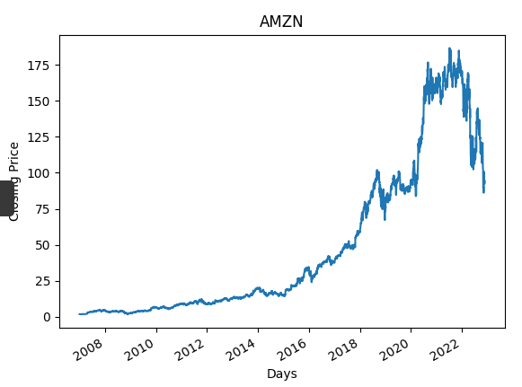
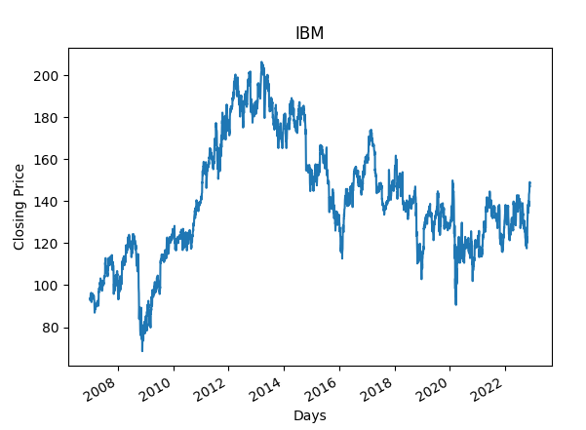
Some Sample Stock-Data

Slide 6
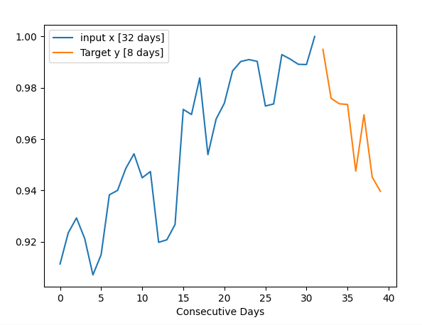
Data Points Visualized.
An example Datapoint is shown for T = 32, N = 8 days.
We used Min-Max scaling of prices to [0,1]

Slide 7
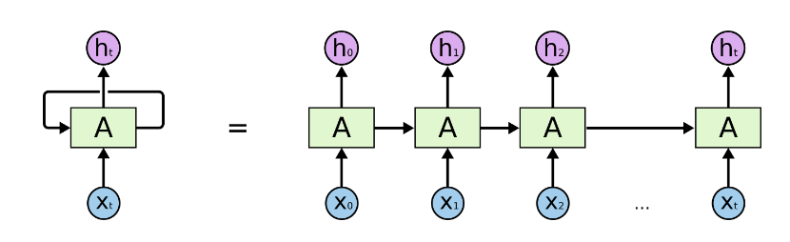
Overview of RNN.
Stock Price Prediction is a Sequential Data, and thus Normal Feed-Forward Neural Networks cannot be used for this task, as there is no notion of a sequence of inputs in The Standard NN.
Recurrent Neural Networks address this issue, They are Networks with loops in them, allowing information to persist.

Slide 8
Overview of RNN
While processing a sequence, RNN takes x_{t} as input, and it stores what is called a hidden state h_{t} which remembers the info from the previous time-steps while processing the next timestep.
And that is fed as an input to the next-timestep along with x_{t+1}.
So essentially h_{t} = f( W_{h}h_{t-1} + W_{x}x_{t}), where f is some activation function like tanh, relu etc.
We later experimented on the choice of f
The output o_{t} can be obtained by using another Linear FC layer and passing h_{t} into it. (with bias).

Slide 9
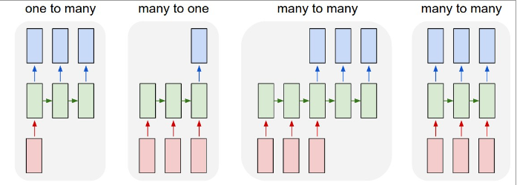
Advantages of RNN
They can be used for Sequences of any length.
They can be used in various Models as shown below,

Slide 10
Architecture Selection
We chose to use the Many-to-one Model, i.e, consider the output at the last-time-step only.
There are many parameters in the Model that we are free to choose,
Choice of (N, T)
Size of Hidden Layer/ State. Also number of RNN units (we chose 1)
Choice of Activation tanh / ReLU
And other parameters like dropout, BatchSize, lr, epochs etc for Training.
We experimented with all the above choices of model, and the results are summarized in the upcoming sections.

Slide 11
About Training
BackPropagation . But in the case of RNNs, we need to unroll the sequence back in time to find the gradients -> BackPropagation Through Time (BPTT).
As this process is sequential through time, it cannot be parallelized, hence BPTT is usually quite slow.
We used a MSE loss, And the Adam optimizer in PyTorch with a 80:20 split on data.
Then trained the model tuning various combinations of (lr,epochs,BATCHSIZE)
Employed Early Stopping, where we saved the model version with best Validation loss

Slide 12
Some Experiments & Results
Batch size, learning rate selection while training
Testing the trained model
Visualizing the Predictions

Slide 13
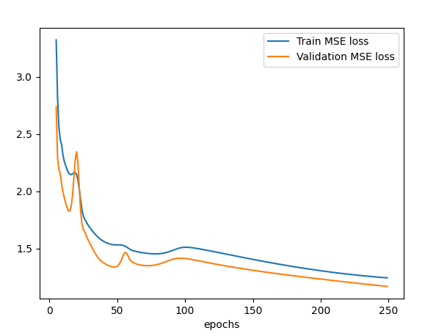
About Batchsize, learningRate etc….
Found optimal B,lr after tuning.
High lr is giving unstable loss curves
So finally chose 256,0.005
More on it in Report….

Slide 14
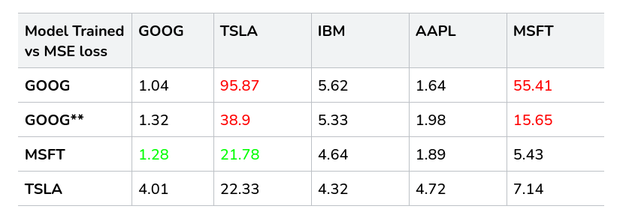
Testing the Trained Model.
Now we have models trained with (T,N,H) = 32,1,32 on various stocks like GOOG, AMZN, MSFT, IBM etc..
We also tested the model obtained from training one stock to other stock data as well.

Slide 15
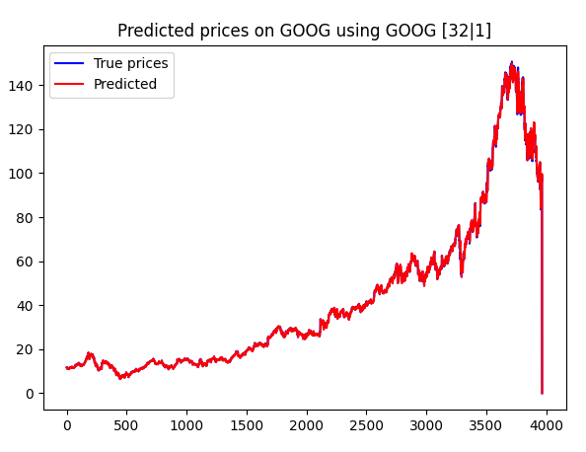
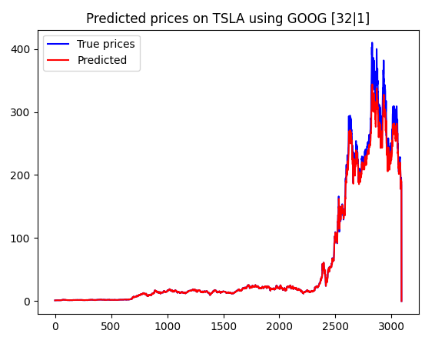
Some Prediction Plots.

Slide 16
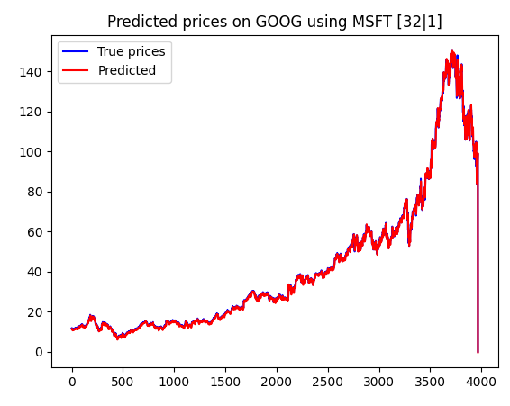
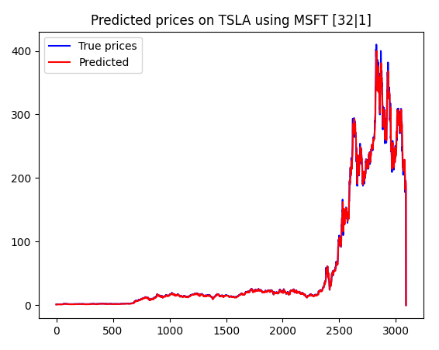
Some more Prediction Plots.

Slide 17
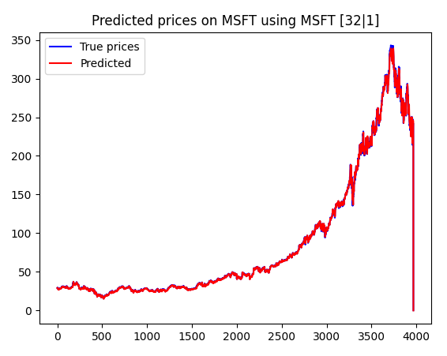
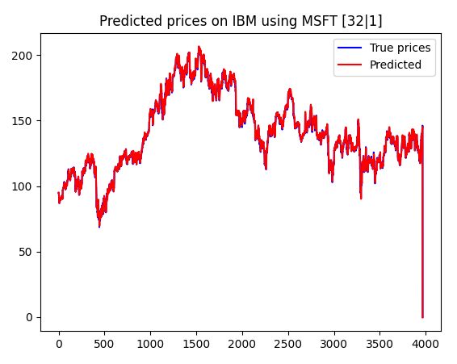
Some more Prediction Plots

Slide 18
Single Datapoint Predictions.
We already saw what a data point looked like
All the above plots were on all datapoints combined
Now we zoom in a little and look at what our model predictions look like for individual data points
I.e, given T days input prices , predict next N days price.
Till now we only analysed N = 1

Slide 19
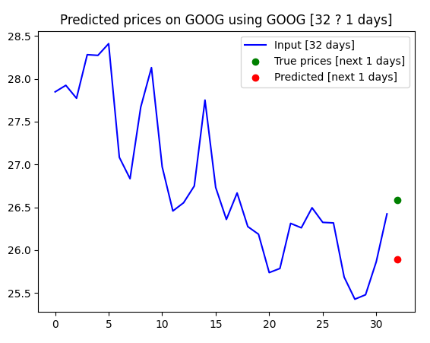
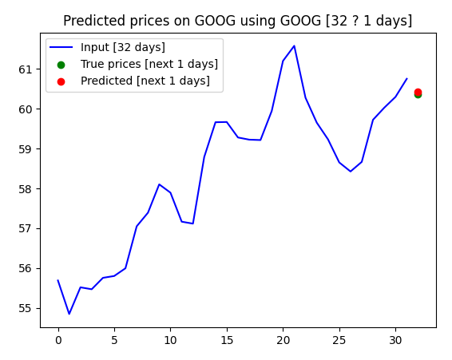
N = 1, some plots .

Slide 20
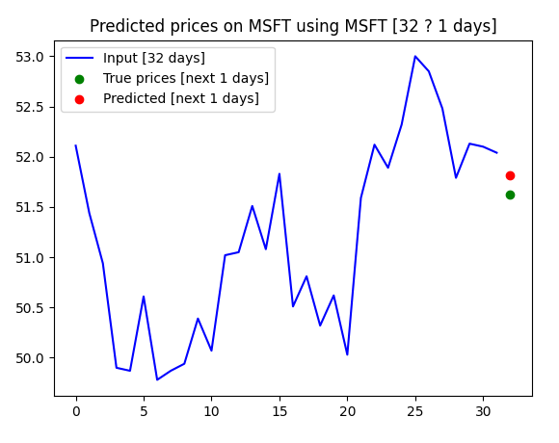
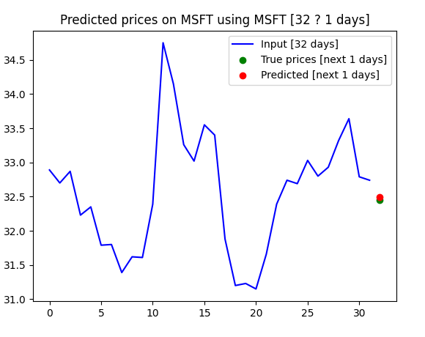
Some more..

Slide 21
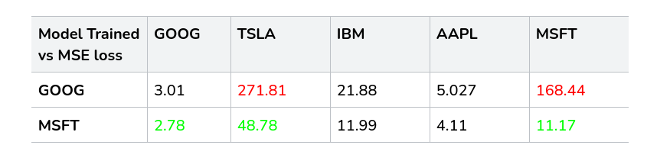
N = 4 case (next 4 days)
Data for N = 4, T = 64( H = 32)
The losses will be higher now, why?

Slide 22
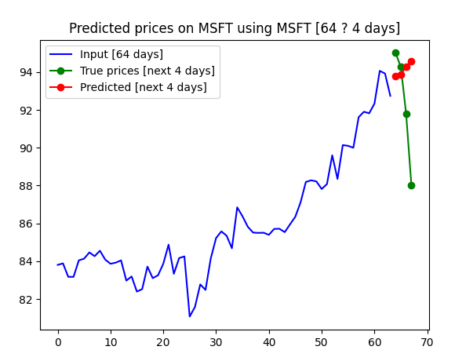
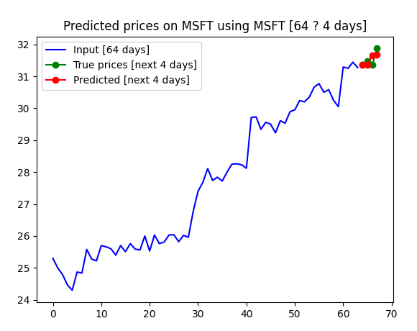
N = 4, some plots.

Slide 23
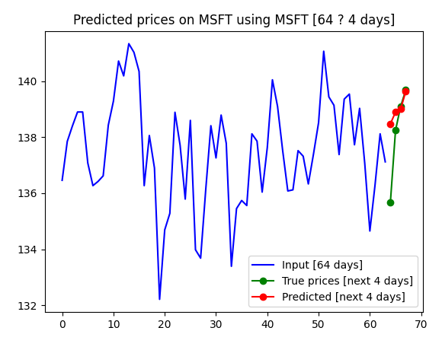
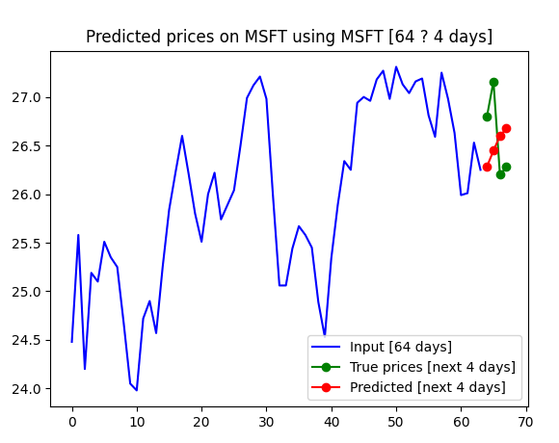
N = 4, some plots.

Slide 24
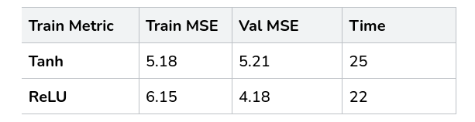
Tanh vs ReLU
In all the above analysis, we used tanh non linearity.
We used both ReLU, Tanh on (T,N,H) = (32,1,32) and the results were:-
Train results were good, and ReLU took lesser time.But while testing ReLU gave more error

Slide 25
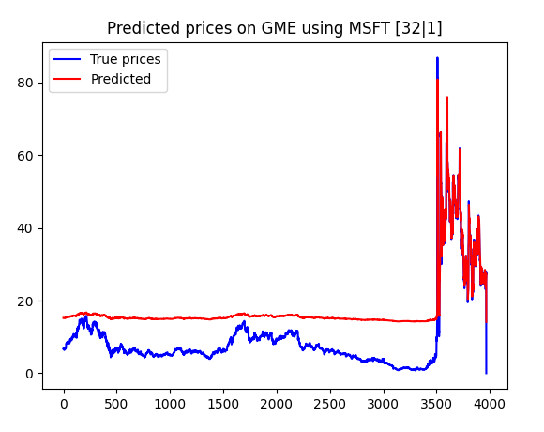
Issues of ReLU
The main Advantages of Tanh are
Smooth
Bounds h to [-1,1], thus preventing explosion
Problem with ReLU
giving errors while predicting low prices
Maybe it suggests something about the “ReLU” nature

Slide 26
Problems with RNNs.
The main problem with RNNs is the problem of Vanishing or Exploding Gradients.
While BPTT we multiply with the same factor multiple times.
Thus it limits the ability of RNN to deal with longer Sequences.
Solution? LSTMs, GRUs

Slide 27
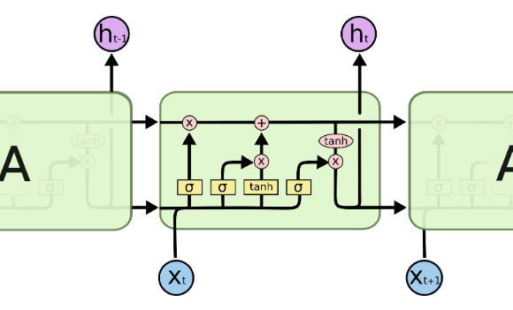
LSTM Overview.
LSTMs are a kind of Recurrent NNs, these address the problems of RNNs.
LSTMs are explicitly designed to avoid the long-term dependency problem.
The recurrent Nature is same as RNNs except that they have a different repeating unit inside, as well as it stores <cell state, hidden state> both.

Slide 28
LSTM Overview
It has 4 gates with sigmoid signals to control the flow of inputs.
It learns what to remember and what to forget.
More parameters, hence train slowly.
This Gated structure does controlled information flow, and also helps in retaining information for longer sequences.

Slide 29
Training & Experiments.
All the Choices Taken are similar to that of RNNs.
We experimented with various settings of (T,N,H) etc.
We used the same loss, optimizer while training.
Training experiments & Results
Testing the trained model & Results.
Visualizing the Predictions.

Slide 30
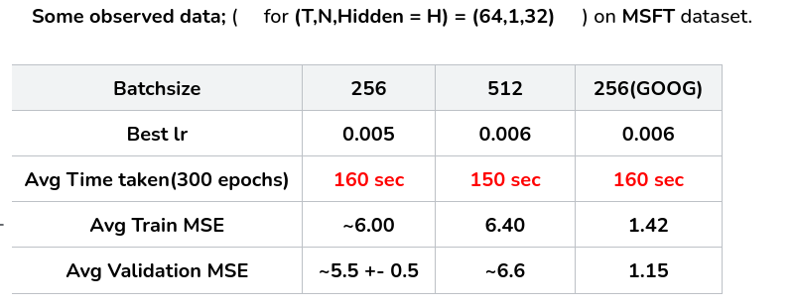
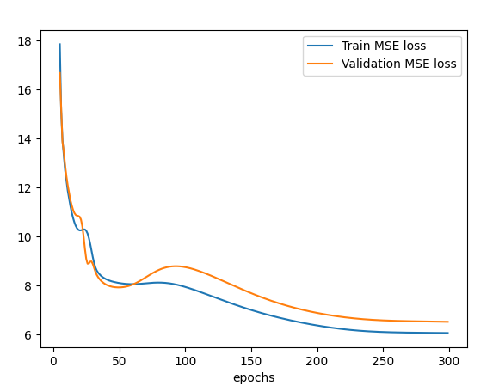
Training
Since training is significantly slower, choose 256 as batch size(512 not so fast)

Slide 31
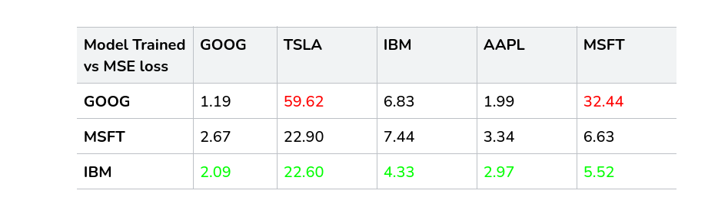
Testing the Models (T,N,H) = 64,1,32
IBM seems to give the better results. Why?
Next: Few Plots :)

Slide 32
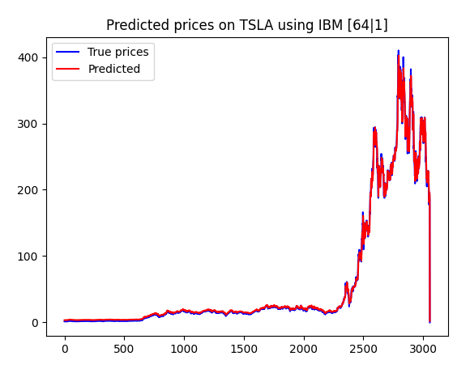
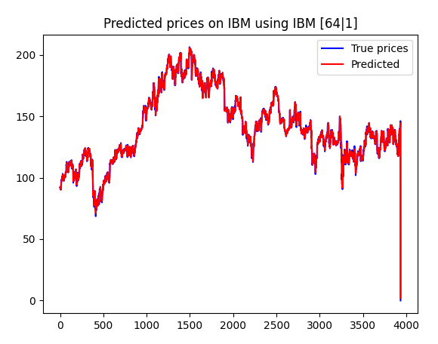
Some Prediction plots

Slide 33
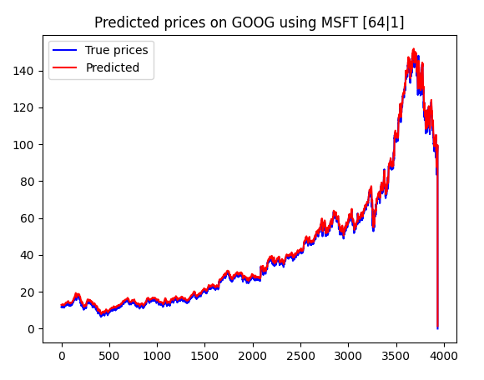
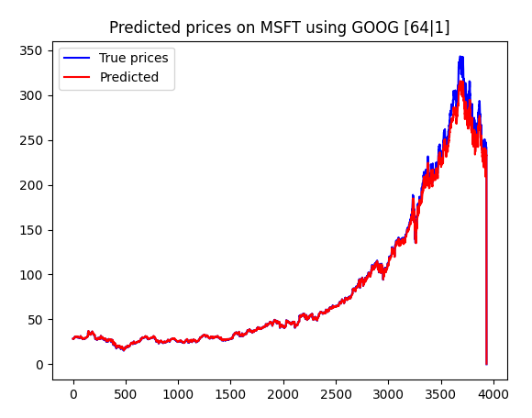
Some…

Slide 34
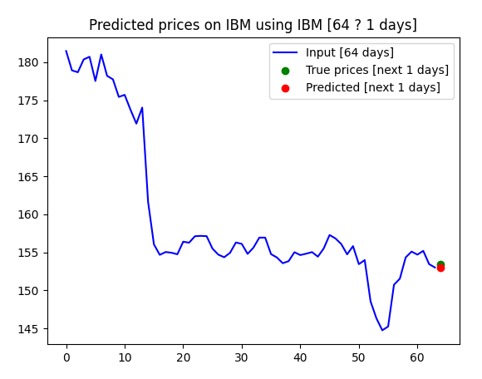
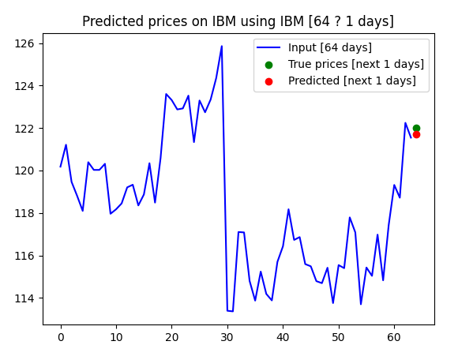
Single Datapoint Predictions (N = 1)
But the error visibly decreased as comp to RNNs. More closer predictions

Slide 35
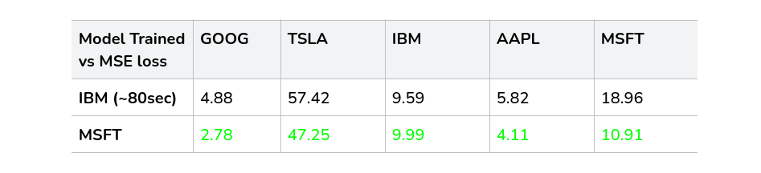
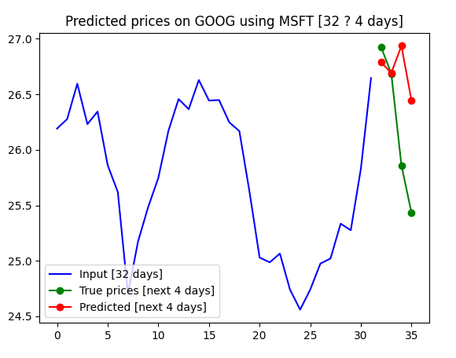
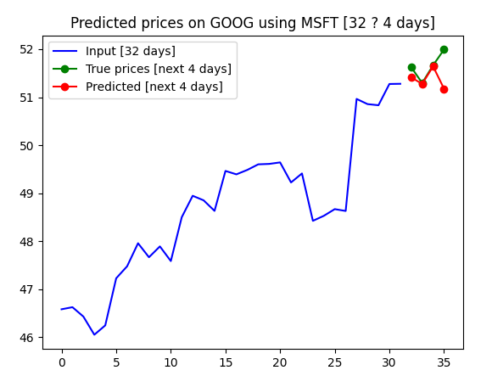
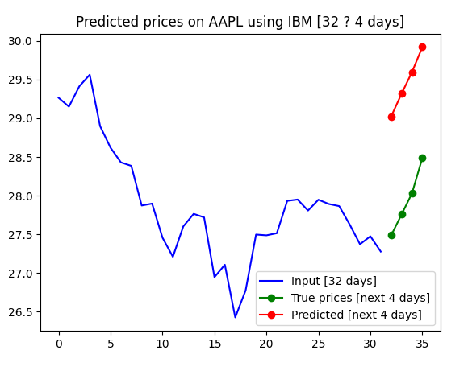
N = 4
Kept T = 32, it reduced the training time a lot!.

Slide 36
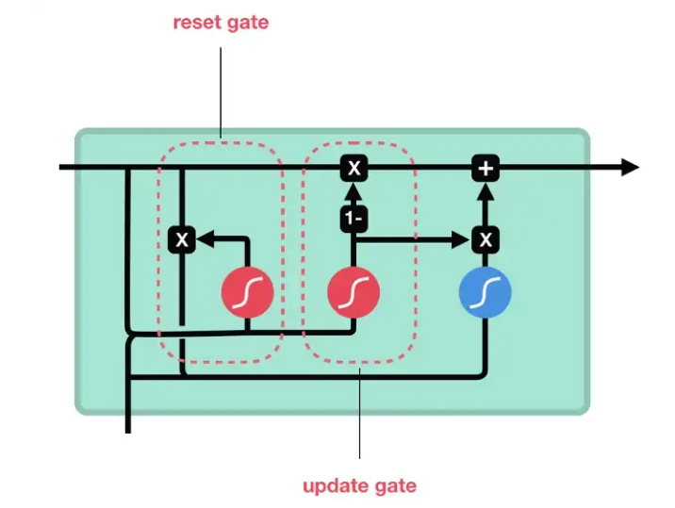
GRUs (Gated Recurrent Units)
Just like LSTMs but different internal structure, less gates. No cell state, So less complex, and faster to train!
All the analysis exactly same as RNN, LSTM.

Slide 37
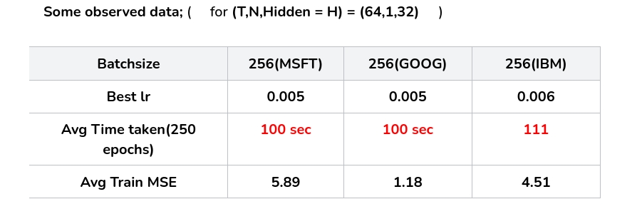
Training Analysis

Slide 38
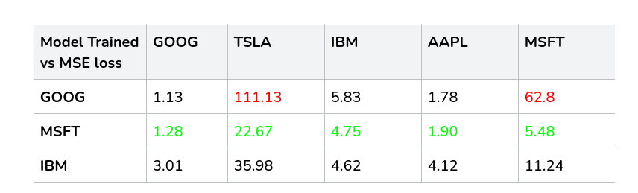
Testing the Models

Slide 39
Comparison Among RNNs
Compared across all 3 Models with N = 1 fixed. And varying T
All models were trained on MSFT stock, and tested on various stocks.
The results obtained are:-

Slide 40
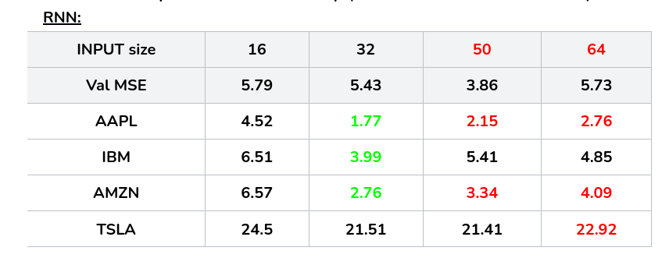
RNN

Slide 41
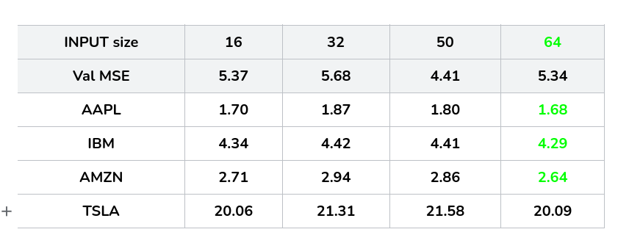
GRU

Slide 42
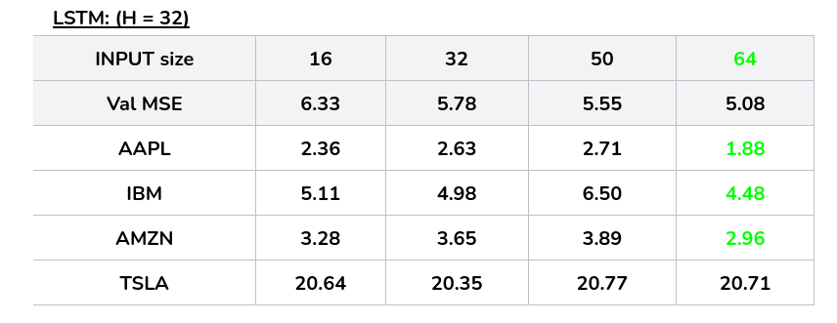
LSTM

Slide 43
Observations
As we increase the Input size, the error should decrease , but in case of RNNs, as we make INPUT size go near 64, the accuracy rather decreases mostly. So it shows that RNNs can't deal with longer Data. But in case of LSTM, RNN as we can see, Error usually decreases in a row. And they give their best results when Sequence length is higher.
If we compare across models with the same test-stock, input size. Then VERY CLEARLY GRU IS THE WINNER. Also GRU has less training time. SO GRU IS THE BEST MODEL BY THE DATA OBSERVED.
LSTM might perform better on even bigger sequences, but we did not perform such analysis because of higher training time costs.

Slide 44
Conclusion
So RNNs are a simple but powerful enough models to capture Time-Series Data.
LSTMs solves the issue of RNNs
GRUs have LSTM properties, as well as simple, hence less training time.
So GRUs are the best model acc to the results.

Slide 45
Recurrent Neural Networks
Transformers
Gaussian Process Regression

Slide 46
Overview of Transformers
We have tried to implement a Transformers based architecture to predict stock market prices.
A Transformer is a neural network architecture that uses a self-attention mechanism, allowing the model to focus on the relevant parts of the time-series to improve prediction qualities.
Combining the self-attention mechanism, parallelization, and positional encoding under one hood usually provides an edge over classical LSTM and CNN models.

Slide 47
Time Embeddings
As the first step of our Transformer implementation, we have to consider how to encode the notion of time when processing our stock prices
Without Time Embeddings, our Transformer would not receive any information about the temporal order of our stock prices
We implemented the approach described in the paper “Time2Vec: Learning a Vector Representation of Time”
This approach represents time as vectors with 2 patterns
The non-periodic pattern is “wt + φ”
The periodic pattern is “sin(wt + φ)”

Slide 48
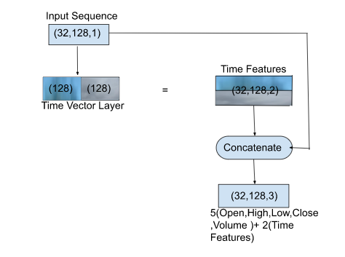
Feeding The Transformer
A combination of time vector representation with price and volume features is used as input for our transformer

Slide 49
Attention Mechanism
The self-attention mechanism consists of a Single-Head Attention and Multi-Head Attention layer
To further improve the self-attention mechanism the authors of the paper Attention Is All You Need proposed the implementation of multi-head attention.
The functionality of a multi-head attention layer is to concatenate the attention weights of n single-head attention layers and then apply a non-linear transformation with a Dense layer
Having the output of n single-head layers allows the encoding of multiple independent single-head layers transformation into the model
Hence, the model is able to focus on multiple time-series steps at once

Slide 50
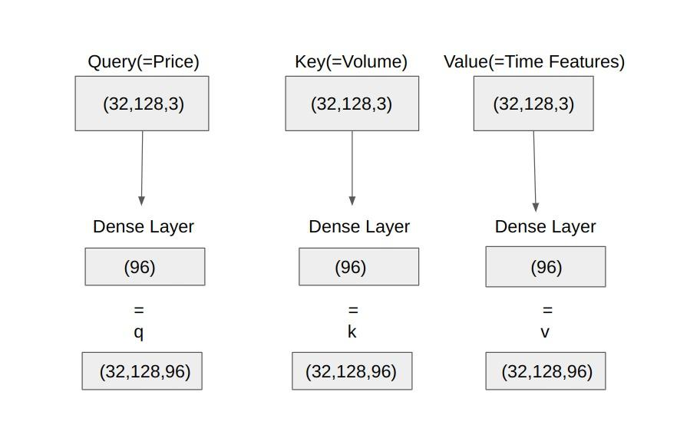
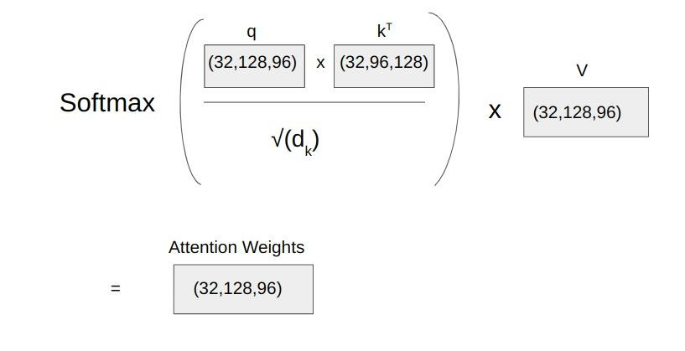
Single-Head Attention
The input we fed to the transformer is the initial input to the first single-head attention layer. The single-head attention layer takes 3 inputs (Query, Key, Value) in total

Slide 51
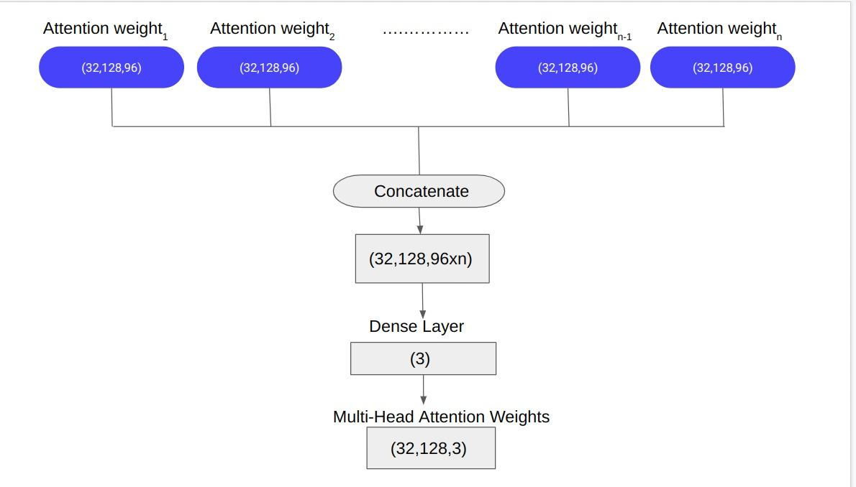
Multi-Head Attention
It concatenates the attention weights of n single-head attention layers and then applies a non-linear transformation with a Dense layer

Slide 52
Encoder Layer and Data-Split
Each encoder layer incorporates a self-attention sublayer and a feedforward sublayer
The feedforward sublayer consists of two 1-dimensional convolutional layers with ReLU activation in between
Each sublayer is followed by a dropout layer.
After the dropout, a residual connection is formed by adding the initial Query input to both sublayer outputs.
The normalized data is split into train (80%), validation (10%), and test (10%) data in the proportions mentioned in brackets
The model is trained on the training data for 20 epochs
After each epoch, the validation loss is calculated and the model which gives the best validation loss is saved

Slide 53
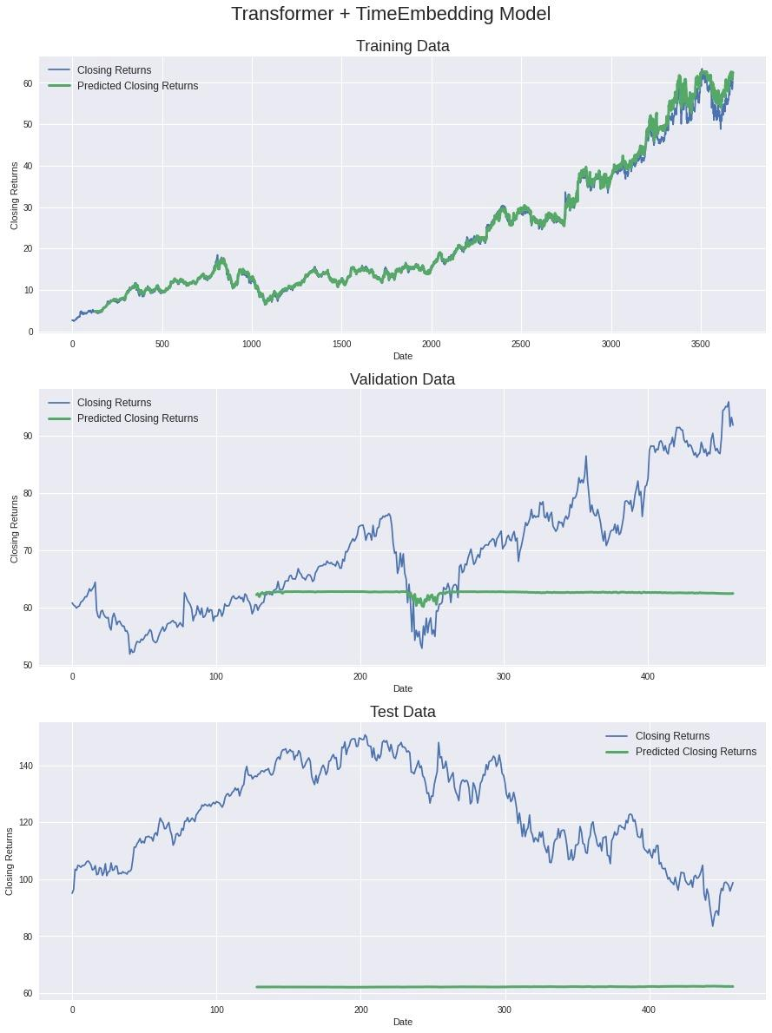
Results

Slide 54
Conclusion
The transformer model is just predicting a flat line that is centered in between the daily stock price changes.
Upon clearly observing the graphs for validation and test data, we can infer that the problem is with the choosing of training, validation and test datasets.
The test and validation datasets have values higher than the maximum value in training data.
Hence, for these, the maximum value of training data is always predicted.

Slide 55
Recurrent Neural Networks
Transformers
Gaussian Process Regression

Slide 56
GP
There are GP methods using which we can do the stock prediction.The main idea is to choose the Kernel function to Meet the task.
K(u,v) = μ²exp( - ||u - v||₂² / 2σ²) , θ = [σ, μ] are the set of parameters.
Now given test data X, we need to predict y. So we need to maximize the Marginal LIkelihood P(y|X, θ) wrt θ
So θ = argmax_{ө}P(y|X, θ)

Slide 57
GP
So we can minimize the Negative-log-likelihood instead.
So θ = argmin_{ө}-ln( P(y|X, θ) )
θ = argmin_{ө}( y^{T}(K(X) + σ_{n}²I )⁻¹y + ln( det( K(X) + σ_{n}²I ) )

Slide 58
Thank You

